Slide 1
Building a Governance Model
for your Compete Program

Slide 2
“Improvements will be temporary unless the enterprise addresses how functions set and keep their commitments to the businesses they serve.”
— McKinsey
Notes:
We introduce new systems and tools all the time - unless you bake-it-in to your existing ways of working/hygeine - you won’t see long term success. You need buy-in from all stakeholders, clear understanding of how to work together and what’s expected. Otherwise you won’t sustain momentum and see long term success.
Quote comes from one part of a 7 part series by McKinsey breaking down how companies can improve the effectiveness and efficiency of their business.
This quote around governance is a great one to tee up in the context of compete programs:
I wanted to kick things off with this quote from McKinsey’s series breaking down how companies can improve the effectiveness and efficient of their business.
Hands up if you’ve taken on a project or initiative (hey, maybe it’s compete!) that you’re starting from scratch. There’s some initial success, but then it becomes really difficult to keep the wheels moving.
How many of you in attendance feel that you’ve set clear expectations around how your compete program will support business objectives? Does everyone know who your program will primarily support? Who will be involved? How will the program be held accountable? What won’t your program support?
That’s why we’re here today.
Source: https://www.mckinsey.com/capabilities/operations/our-insights/lever-six-organization-and-governance

Slide 3
What is a governance model?
Who’s involved?
What are our roles?
How do we work together?
How do we measure success?
A scalable system to help manage a project or program by addressing:
Notes:
By building out a governance structure, people know who is accountable, how decisions are made and by whom. This will help monitor risks, ensure issues are addressed, and will set you up to optimize your process in the future.

Slide 4
Why create a governance model?
4.
1.
Align & Organize
Governance starts with clear accountability for roles & the org structure that supports.
Execute & Automate
Tools, training, playbooks and more support the execution of processes.
Governance
3.
2.
Codify Agreements
Agreements among stakeholders are captured, which reflects the boundaries of what is and isn’t acceptable.
Drive Consistency
Processes define the steps and roles in support of policy and ensure consistent execution.
Source: Altimeter Group
Notes:
Source: Four Ps of Social Business Governance - Altimeter Group
By building out a governance structure, people know who is accountable, how decisions are made and by whom. This will help monitor risks, ensure issues are addressed, and will set you up to optimize your process in the future.
You can tackle questions like: What do we expect to happen? How frequently should we be meeting? What are the boundaries between our roles? What is is not acceptable, what's inbounds, what's out of bounds? And basically, you want to make sure you define the processes so that people can actually follow the steps that they need to take.
It’s really a foundation that will allow your program to scale.
For example, if you’re a team of one, you’re likely covering a lot of bases. You might be the researcher, the enabler, and the product marketer, all wrapped in one! But mapping out your governance model — regardless of your company size — will put you in a much stronger position to outline things like how additional headcount would fit into your compete program (would they take on intel collection and research, and adding ‘why it matters’ while you invest more time in training and enablement for example), how technology would support the program’s goals, or how you’ll support an additional stakeholder group.
If you’re an enterprise organization, it allows you “eat the elephant one bite at a time”, by setting expectations across the organization especially when there are far more hurdles to overcome when comes to getting visibility and comm’ing with different departments.

Slide 5
How do you build a governance model?
1
Stakeholder Identification
Identify key decision makers
Identify who provides input and receives output
2
Organization Structure
Review existing organizational structure
Establish escalation hierarchy and authority levels
3
Roles & Responsibilities (RACI)
Identify roles and contribution
Determine specific tasks for each role
4
Process & Compliance
Determine workflows, tasks, deliverables & audit process
Establish common understanding of how working together
5
Metrics
Commit to success criteria
Establish measurable KPIs
6
Communications Plan
Establish who needs what information and when
Share plan and process with key audiences as needed
Notes:
So if you were to kick off Governance structure, here are the basic components that you would need in it.
Stakeholder Identification: you always want to identify who are your stakeholders and stakeholders will change over the life cycle of a program or a project. And you don't know them all at the very beginning. But basically you will start tracking ‘who are my key stakeholders at the beginning’, and that will evolve over time through the project. So if I talk to you and then I find out from you that, ‘Oh, I should have invited Brendan to the meeting’, now I know my stakeholder list is evolving.
Organizational structure & RACI: the second component is outlining not only what your program organization looks like? But also it's very helpful to understand what the organization of my company looks like because that plays into identifying stakeholders. [INSERT EXAMPLE IF POSSIBLE. And RACI is the next step in defining stakeholders — Who is responsible? Who has authority? Who is consulted? Who is informed?
Process/Compliance & Metrics: First and foremost, you want to be able to measure how successful your program is. So what are those metrics driving your program? Is it the number of users? Is it successfully rolling out a pilot project? What is generally the benefit or the outcome you're trying to achieve through this program? Is it everybody having more information about compete? You need to establish these metrics, and build a process that works toward achieving these metrics AND a process for how you communicate progress/success of your program… which leads us to the last component…
Communication plan: this is as it sounds. Tackling questions like ‘how frequently are we meeting? Who's coming to those meetings? How do you how do you actually plan to meet? How do we report on performance?”. Do we communicate through an email? Is it a text? Is it an actual weekly meeting, a monthly meeting, a quarterly meeting? What is your plan for communications?

Slide 6
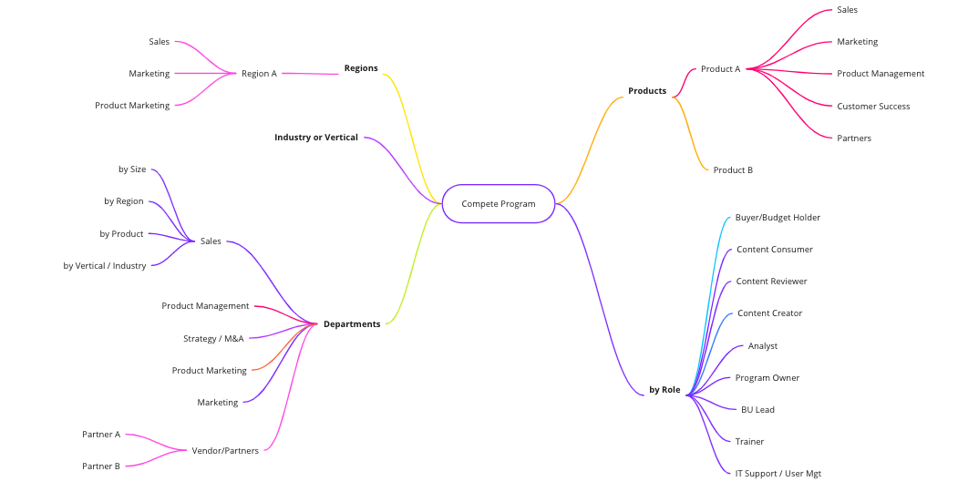
Identify your stakeholders
Brainstorm and document using a stakeholder or mind map.
Notes:
First off, let’s identify your stakeholders! A way that we see compete programs kick this off successfully is by mind mapping (like this example here) in Miro or whatever whiteboarding tool you use.
But really what you're trying to do is think about what is the impact of your program, who is impacted by this change that you're bringing about or this objective that you're trying to achieve. For example, your compete program might have vendors, suppliers, and partners involved. Or it could just be internal to your own department, and then you might get really more granular and just list out specific people's names. For example, you could be saying, ‘Oh, Europe is impacted or Asia is impacted’ and then, ‘oh, who in Asia is impacted? And then you get more specific, right?
You could say let's start with sales as our primary audience, for example. And then let's blow those out — what regions do we support for sales? What product lines? What segment? What industry?
By diagramming or listing out teams, departments, or vendors involved, you can identify who is actually engaged with your program, department or content.
As you identify those key stakeholders, you’ll then begin to put them into your RACI sheet, which we’ll get into later in the presentation.

Slide 7
2. Determine your organizational structure
EXAMPLES
Centralized | Hub | Dandelion
One person or team responsible for all CI strategy and initiatives. Centralized owner / governance. | Multiple teams responsible for CI with shared intel & content. Centralized owner / governance. | Multiple, distributed teams owning CI strategy and execution. Multiple owners / joint governance.
Notes:
Okay, so here are a few examples of how we’ve seen compete programs structure themselves within an organization.
Centralized: The first is centralized. This is a single person or team that is responsible for all of CI. When you're small and just starting up as a growth company, you don't have that many communication paths or communication challenges because it's just you (or your team) and you get to decide ‘this is the way of working’. If people don't like the way that you're working, you can change it because you're responsible for everything quite easy. But most of all, the responsibility and the governance are either in that single person or a team manager and that’s responsible for all of CI.
Many compete programs within our customer base are compete teams of one → I'm a CI manager, I'm responsible for X audiences. There’s not a lot of governance required. In these cases, the successful ‘teams of one’ spend more time up front on stakeholder identification, defining their process and measures of success, and their communication plan for distributing insights and reporting out progress.
Hub - Multi Curator Teams: But, then need for more formal governance comes into play with the hub structure for a compete program. Let me share an example from this hub model mentioned earlier. One of our enterprise customers launched their Compete program. The program is based in the EMEA market and primarily supports EMEA teams. However, the North American arm of the business saw the success their compete program was having and wanted to establish a compete program themselves within North America. Now, in this example the compete teams are for the most part going to operate separately, however there will be overlap. That’s where governance comes into play. Your trigger is when you have to share your way of working or work together.
Right now the CI lead in EMEA has their way of working their own time zone, their own content, their own structure reports, their own division, and doesn't report to this US division. There's no head of CI, no centralized CI. Now, you've got these people over here that want want to do their own thing in North America their own way. But there needs to be a governance group and line of communication between these teams when ‘triggers’ occur that affect both of them. For example, there may be one executive that you both report to. Or a large competitor acquisition occurs that impacts both of your stakeholder groups and as such impacts both of your programs. NOW: how do we inform somebody about this? What's our way of working? Who's responsible? What's our communication path? As soon as you have shared anything, be that an audience information, you're going to look at governance.
Dandelion: The last example is Dandelion, which is predominantly for large enterprise organizations. There are multiple different Compete teams that are working independently across VERY different products, and have entirely different processes. There needs to be somebody — or a team — that sits in the center of it all as the governance arm, allowing some flexibility in the process for these little spokes in their way of working.
Think of it within the context of a company that regularly acquires other companies. When you acquire, you can either like meld into one common process or you can keep that acquired company operating totally separately and differently. And it's kind of in that sense, you may have very slim common processes, but you're operating wholly separate. But we need to know how you're working. And maybe we have to meet only on a quarterly basis to check in. This is getting more and more complex because people are kind of shaving off and operating very independently and they become more and more like the clusters. And the size of those clusters are bigger. But there still needs to be a core that binds these clusters together.

Slide 8
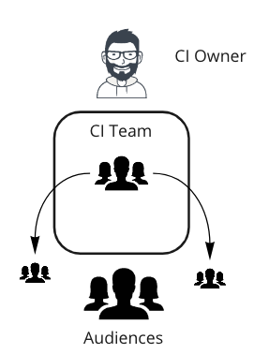
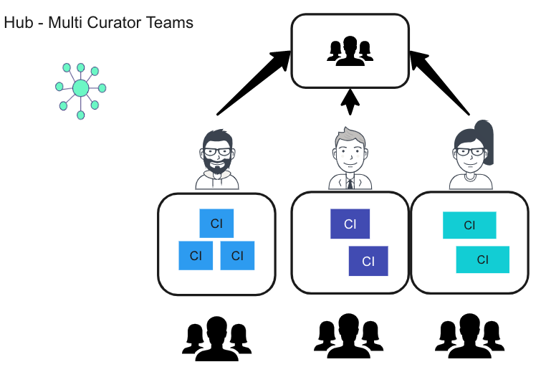
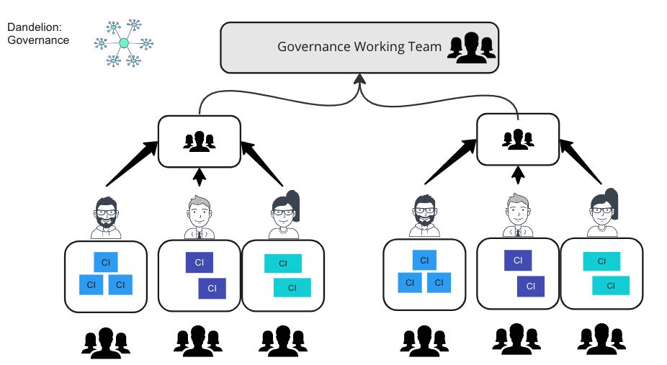
Structures in practice
Centralized
Governance is typically built into departmental operations.
Hub
Dandelion
Global governance is required.
Global governance is required.
Notes:
Centralized: So, many compete programs within our customer base are compete teams of one. I'm a CI manager, I'm responsible for X audiences. There’s not a lot of governance required. In these cases, the successful ‘teams of one’ spend more time up front on stakeholder identification, defining their process and measures of success, and their communication plan for distributing insights and reporting out progress.
Hub - Multi Curator Teams: But, then need for governance comes in to play. Let me share an example from this hub model mentioned earlier. One of our enterprise customers launched their Compete program. The program is based in the EMEA market and primarily supports EMEA teams. However, the North American arm of the business saw the success their compete program was having and wanted to establish a compete program themselves within North America. Now, in this example the compete teams are for the most part operating separately, however there will be overlap. That’s where governance comes into play. Your trigger is when you have to share your way of working or work together.
Right now the CI lead in EMEA has their way of working their own time zone, their own content, their own structure reports, their own division, and doesn't report to this US division. There's no head of CI, no centralized CI. Now, you've got these people over here that want want to do their own thing in North America their own way. But there needs to be a governance group and line of communication between these teams when ‘triggers’ occur that affect both of them. For example, there may be one executive that you both report to. Or a large competitor acquisition occurs that impacts both of your stakeholder groups and as such impacts both of your programs. NOW: how do we inform somebody about this? What's our way of working? Who's responsible? What's our communication path? As soon as you have shared anything, be that an audience information, you're going to look at governance.
Dandelion: The last example is Dandelion, which is predominantly for large enterprise organizations. There are multiple different Compete teams that are working independently across VERY different products, and have entirely different processes. There needs to be somebody — or a team — that sits in the center of it all as the governance arm, allowing some flexibility in the process for these little spokes in their way of working.
Think of it within the context of a company that regularly acquires other companies. When you acquire, you can either like meld into one common process or you can keep that acquired company operating totally separately and differently. And it's kind of in that sense, you may have very slim common processes, but you're operating wholly separate. But we need to know how you're working. And maybe we have to meet only on a quarterly basis to check in. This is getting more and more complex because people are kind of shaving off and operating very independently and they become more and more like the clusters. And the size of those clusters are bigger.

Slide 9
3. Establish roles and responsibilities
EXAMPLES
Program
Lead
Business Unit Leads
Steering Committee
Global governance of process / alignment
Track BU performance
Program steering
Track programs / outcomes
Train BU users
Review status
Assess program & project impacts
Monitor team adoption
Approve budgets
Report progress
Raise/escalate concerns
Decide on escalations /
global issues
Notes:
This is a view of the typical roles that show up in Governance meetings.
Program Lead
The person overseeing the total program
They will be tracking process and outcomes, reporting on progress, establishing processes and alignment, and measuring success of the program
SteerCo
Your SteerCo will generally be consulting. They're just there to check in on on progress. Maybe there's an escalation. Maybe they're the ones who approve your budget for your program. If there's an issue between different groups or departments that for whatever reason, the team can't resolve, maybe they are the deciding factor.
BU Leads
You can also bring BU leads in to get greater buy-in. If I'm sales, I want to make sure sellers are using competitive content in deals. Then maybe the sales ops or sales enablement manager is there and they're tracking their sales team performance and they're training their team. They're basically going in and checking in for this department or this team. How well are we doing?

Slide 10
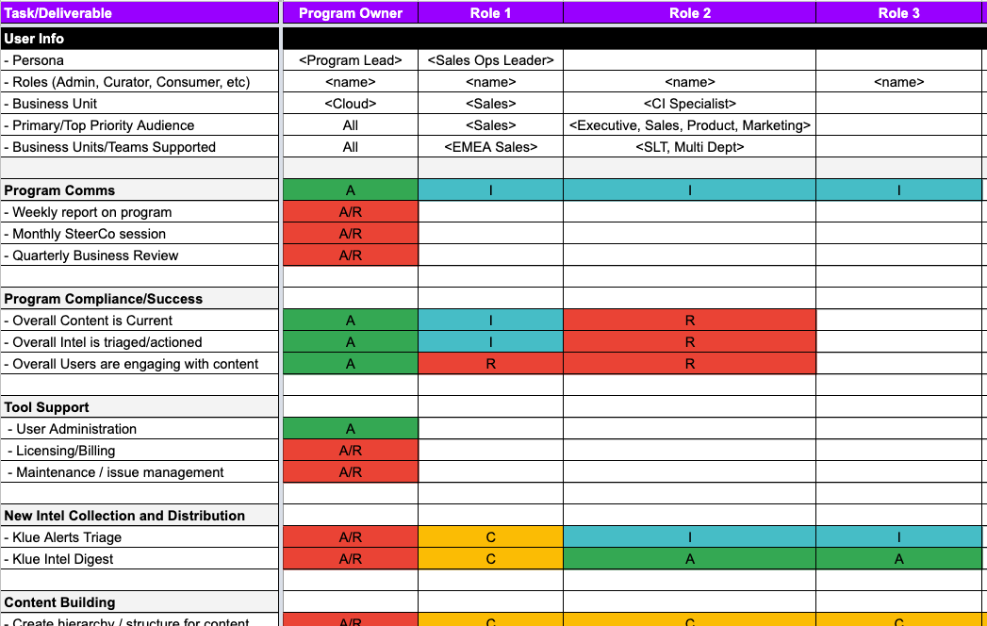
RACI - Responsible, Accountable, Consulted, Informed
Complete a RACI sheet to document who is involved, what your process is and who is responsible for what.

Slide 11
4. Determine the process
Triage | Importance levels of news? | Who deletes? | How frequently do we monitor news?
 | What triggers an event? | Who needs to know / format? | Urgency of messaging
Share Intel | What intel is shared? | Who adds ‘Why it Matters’? | Who/when to publish to feed?
Create Content | Review Process | Expected frequency of updates | Who approves? | When to publish?
Newsletter Creation | Ownership | Who adds content / format / style? | Audience? | What audiences are shared/ not?
Admin | Who manages permissions? | Who needs access to reports?
This should all feed into your RACI activity sheet.
What are your event triggers & responses?
Notes:
What is your compete program’s ‘way or working’?Compliance: Who checks to make sure this is getting done?
This is just an example of the different processes and steps required to run your compete program. There’s likely a lot more flexibility here, but for some in attendance this could be a good building block to work off of. You’ll input this into your RACI sheet.
Throughout this, you need compliance! WHO is making sure these tasks get done? This is more difficult when you’re a team of one that has to try and hold yourself to account.

Slide 12
5. Commit to your success measures
What should be done at what frequency?
Success Measures
Weekly
Monthly
Competitive win rate
Competitive newsletter
Department meeting
Content adoption
Team meeting
Training / Issue Management
EXAMPLES
Seller competitive confidence
Project progress reports
Process/compliance reviews
Newsletter open rates
Check compliance activities (ie Intel collection, Content updates)
Success metrics reporting
Customers won from competitors
Notes:
So here are some of the things that you could be communicating or reporting on at a certain cadence.
Weekly
For example, your competitive newsletter can be a weekly or bi-weekly touchpoint for your audiences. Maybe your sellers get a more frequent one specific for them, but execs get a less frequent and bigger picture newsletter. Your newsletter is a crucial way to build your compete brand internally (and Jenny from Algolia will be sharing how you can build your compete newsletter on day 3 at Compete Week!).
This is also weekly touchpoints amongst your working teams, making sure day-to-day tasks are getting done
Monthly
Larger reviews
You could be reporting success metrics in the far column here too, or maybe just adoption and consumption rates.
As mentioned earlier, these monthly meetings are opportunities to launch projects or initiatives
Quarterly
And that quarterly cadence needs to be concise, reporting on metrics, accompanied with briefs for your execs beforehand. [Walk through metrics + win-loss]

Slide 13
6. Craft your communications plan
Audience
Frequency & Purpose
Actions
Review past quarter results
Global training needs
Process change approvals
Issue escalations
Executive Team
Quarterly
Approvals
Monthly
Discuss progress
Identify challenges/hurdles
New initiatives / updates
Escalation Path
Program + BU Leads
Review Status
Approve Changes
Weekly
Working Team Sync
Working Team
Day-to-Day Management
Issues / Impacts
Notes:
This slide goes back to the communication plan mentioned at the top. We’ll get into what you can and should communicate next, but first establish a cadence of how regularly your communicating and with what specific groups.
As you can see, the closer the working group or individual is to the program, the more regularly you’re meeting.
Working team: Starting with your core working team → Who are you going to have a weekly meeting? Who's who's generally at it? It could be your business unit in the working team having a sync. And it's just day to day management.
Program + BU Leads: Next level, maybe you're meeting monthly, You're checking out challenges. Maybe you have a new initiative or an update. And that's your leads. Maybe your business unit leads, or your program manager and business unit leads are generally at this monthly meeting. And then you could have an executive in there. Depends again how big your company is, right? For example, if you have a new initiative that requires budget, it is easier and more efficient to get the buy-in and resourcing from the budget holders if they’re in this same room together, whether that’s a CMO, Sales Manager, or CPO.
Steering committee: You will probably meet quarterly with your steerco and it's generally just an update. Here's some of the issues we're having. Here's the trends, here's our KPIs and metrics. Maybe they need to approve something as an action. It’s short and sweet. One piece of advice → before the meeting, send a brief and recommendations, so that they can review that content and when you come to the meeting, it's more going to make decisions and taking actions.

Slide 14
Let’s review
1
Identify your stakeholders
2
Determine your program org structure
Building this foundation is key to managing a successful compete program that will scale as your business grows.
3
Establish roles & responsibilities (RACI)
4
Determine the process
5
Commit to your success measures
6
Craft the communications Plan
Notes:
RECAP → Best Practices
Identify stakeholders
Determine Structures
Determine roles
Comms plan
Timeline
Remember, building this foundation will make your life infinitely easier to kick-off and scale a successful compete program. Even if you don’t go into great detail to begin with across each component, establish them up front and then tweak them as your program evolves and gains traction.
Whether your a team of one getting compete off of the ground or you’re at the enterprise trying to best organize your competitive team and all of the stakeholders across the business that compete supports, having the right model is the key to ensuring that competitive enablement helps drive wins across the business.

Slide 15
Thanks!
Let’s Build 💪
Notes:
TRANSITION OUT TO ROUNDTABLES
I’ve shared an overview of what we’ve seen across our customer base at Klue, but now it’s time for you to connect and learn from your peers that have done a great job at establishing compete with their organization. There will be three roundtables for you to join and pick the brains of the compete teams at Adobe, Shopify, Datto, and Rubrik. Open-floor q&a, so make sure to bring your questions.
Thank you so much for joining me today, and enjoy the rest of Compete Week.

