Slide 1
How to write a must-read competitive newsletter
Algolia
Jenny Sung, Sr. Product Marketing Manager

Slide 2
Algolia Mission:
To power discovery.
Algolia’s Competitive Intel (CI) Mission:
To proactively power Algolia with market knowledge and insights to accelerate deal conversions.

Slide 3
There are 3 primary pillars guide Algolia’s CI mission
Analyze
Influence
Scale
Market research
Competitor tracking
Product research
Deal analysis
Win/loss analysis
Product roadmap
Product / feature positioning
GTM plays
Executive engagement
Analyst engagement
Field enablement (battlecard, newsletter, office hours)
Training
Technical deep dives
Deal support
KPIs:
Positioning performance (Chorus)
# of analysis deliverables
Deliverables:
Executive updates
Positioning documents
PMM x PM learnings
KPIs:
Content delivery
Field confidence (by survey)
Win rate

Slide 4
Competing enablement information
Gold fish
Balancing push vs. pull
Hurdles to get your competitive research out

Slide 5
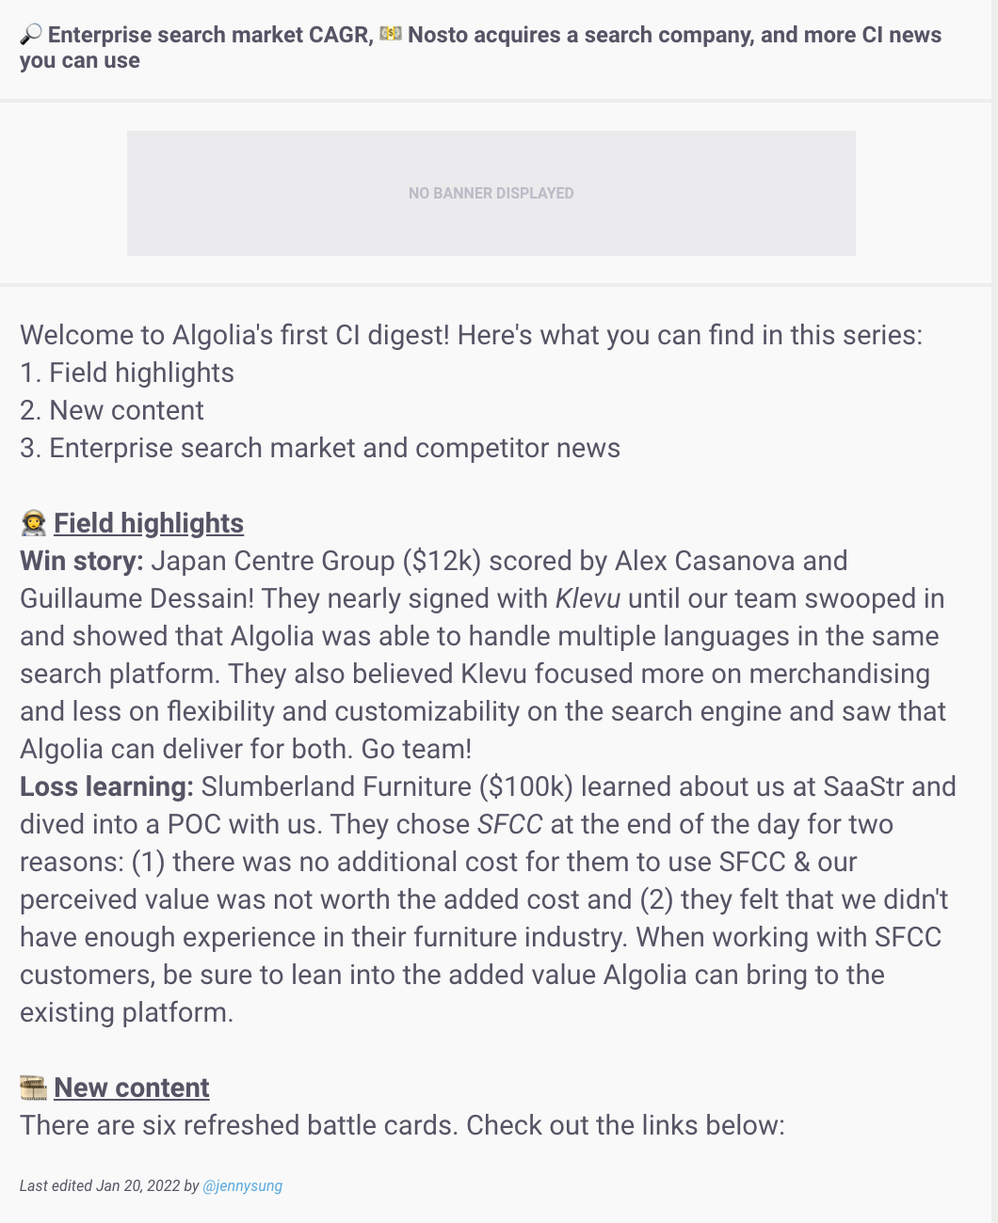
from ~30% open rate
Notes:
Here’s an example of one of the first newsletters I wrote nearly 9 months ago.
It had a 30ish% open rate
Fast forward to today’s newsletter, that frequently gets an 80%~ open rate
The competitive newsletter is one of the most important tools at your disposal to inform your audience and build the brand of compete internally.
So in this session, I’m simply going to walk through how you can get from here to there.

Slide 6
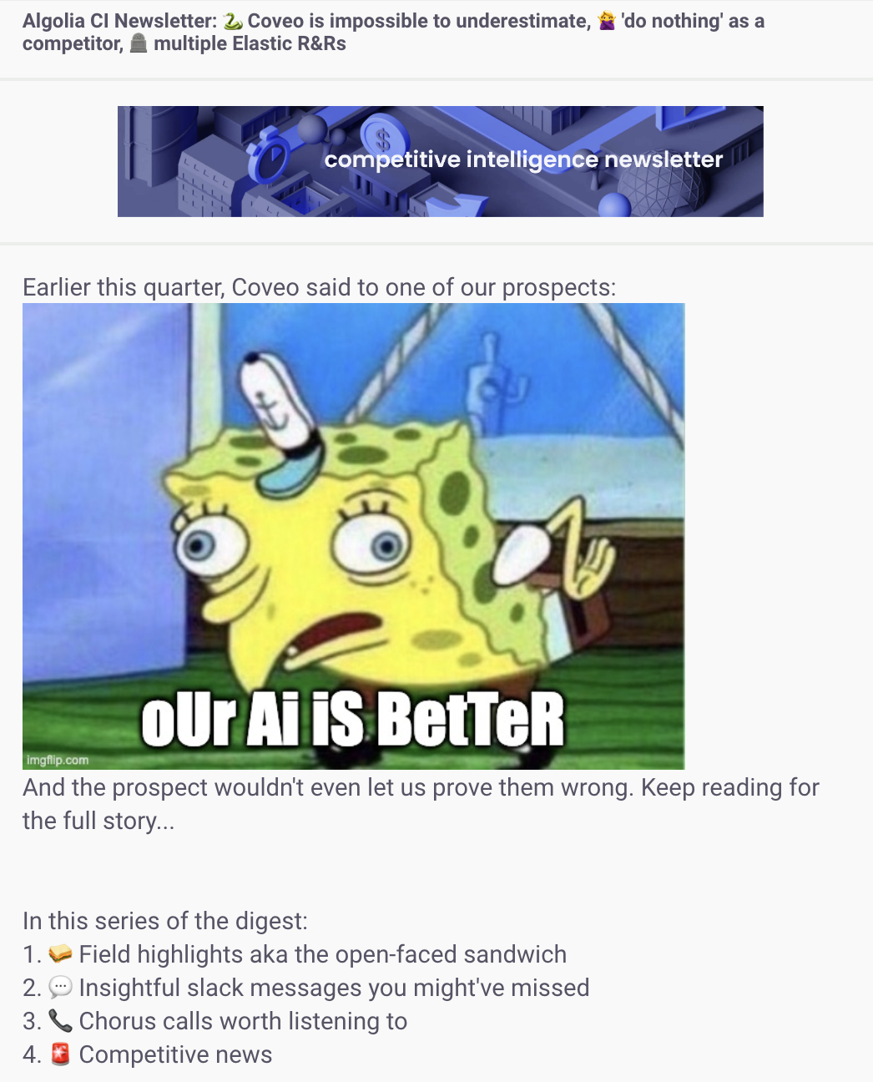
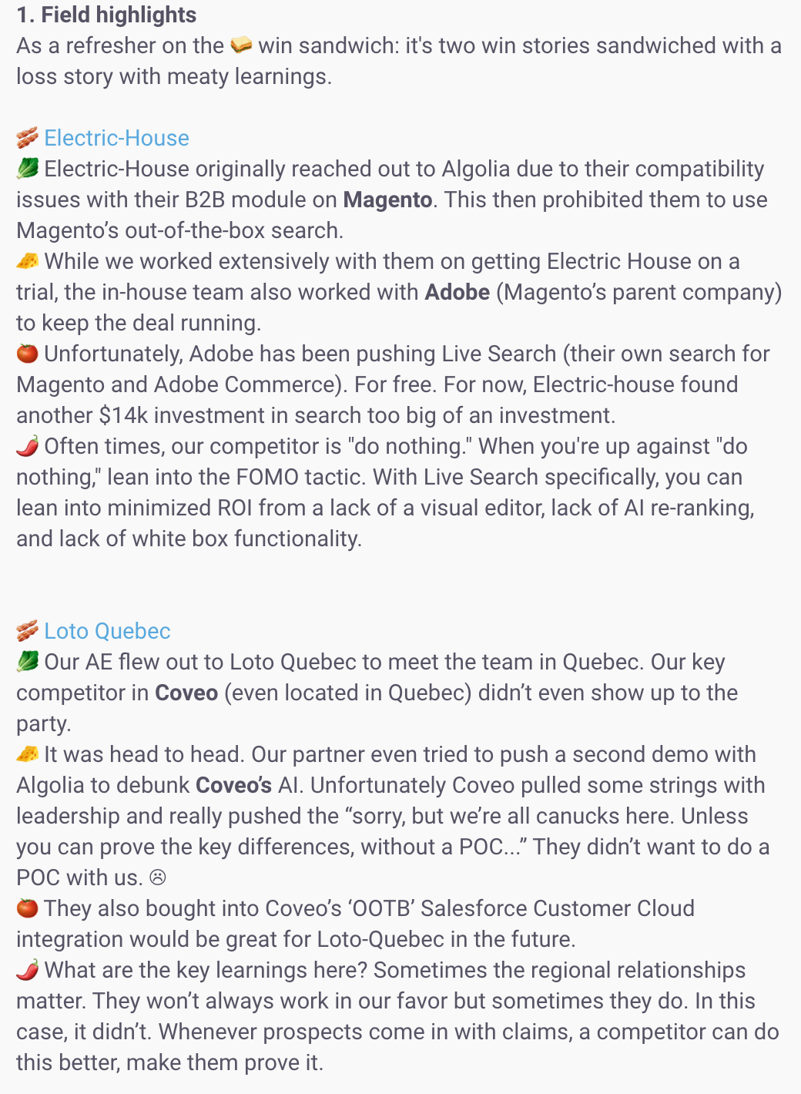
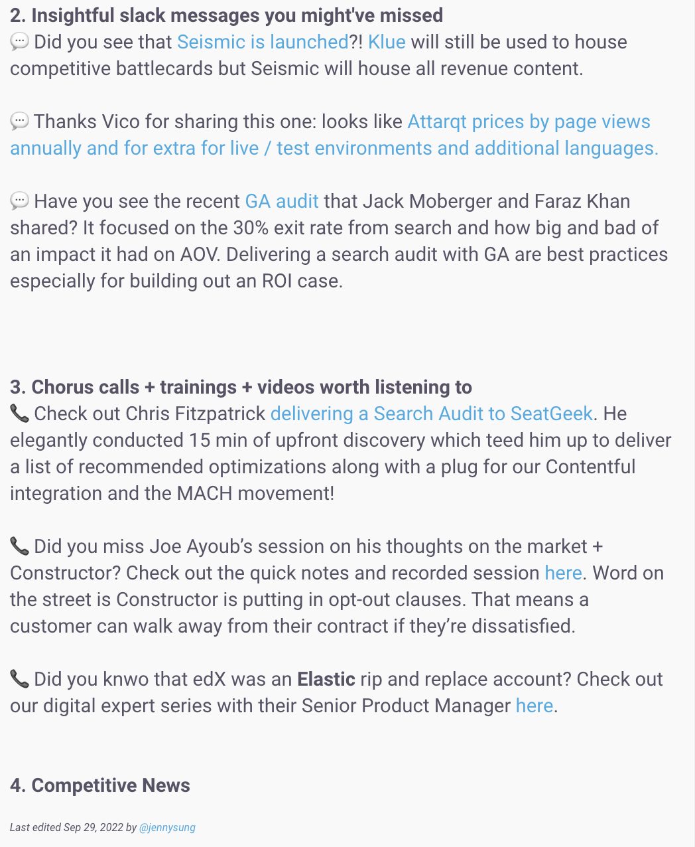
to ~80% open rate

Slide 7
5 strategies to nail your newsletter
1
Keep it consistent
News you can use
Be a human!
Applicable to all audiences
Have a mini ‘GTM’ strategy for your digest
2
3
4
5

Slide 8
Same time, same sections
Last week of the month
Friday mornings
With the same sections:
🥪 Field highlights aka the open-faced sandwich
💬 Insightful slack messages you might've missed
📞 Chorus calls worth listening to
🚨 Competitive news
Keep it consistent
1

Slide 9
Always ask yourself, “what can they learn from this?”
Quick to read (tl;dr)
Key takeaways
What can reps actually do
News you can use
2

Slide 10
No one wants another boring email…
Add humor
Hook them
Use analogies
Be a human!
3

Slide 11
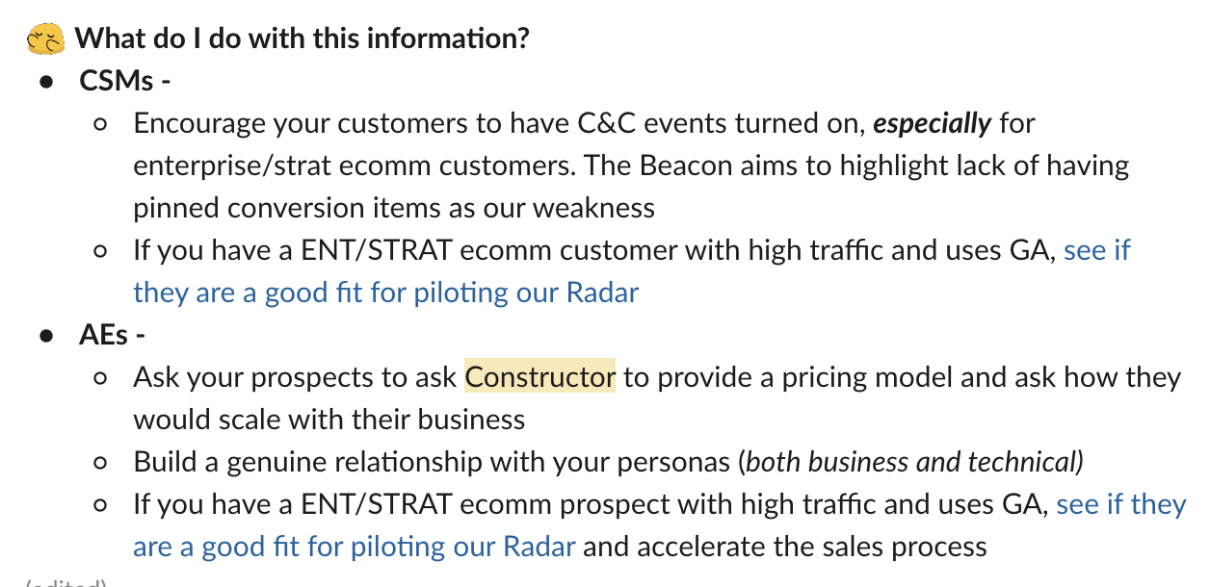
Can all folks in the field use this information?
Account Executives
Solution Engineers
Customer Success Managers
Partner Account Managers
Product Managers
Applicable to all audiences
4

Slide 12
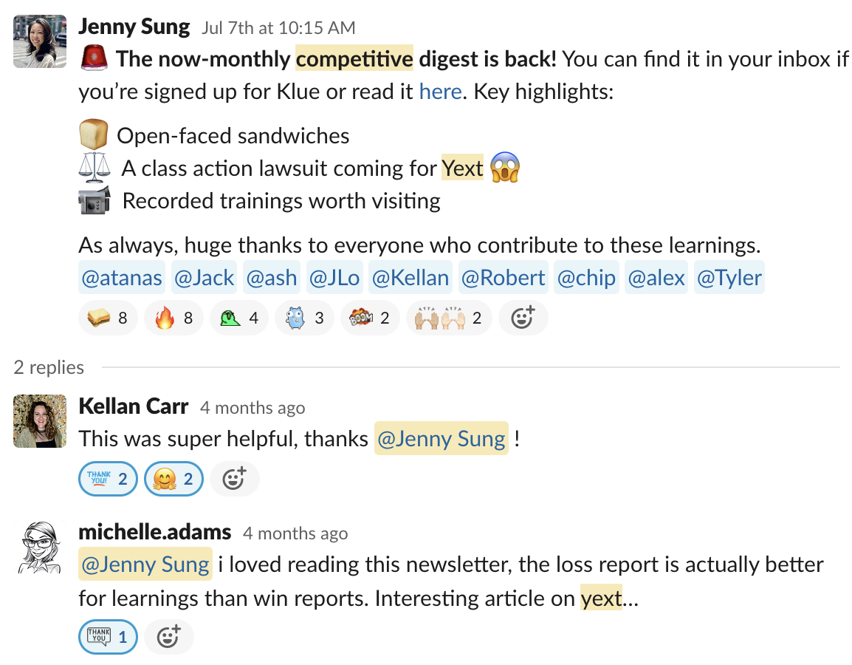
Have a plan to roll out your digest
Make compete an org-wide achievement
Credit seller win stories
Shout-out ‘intel sharers’
Create an ongoing feedback loop
Mini ‘GTM’ strategy
5

Slide 13
Thank you

